Slide 1

Hillsborough County
Tax Collector’s Office
Open Enrollment 2025
Supplemental Benefits Presented by BeneCom
Your Trusted Benefit Consultation & Enrollment Specialists

Slide 2

Benefit Options
Allstate Benefits
  Accident
  Hospital – “SHOP”
  Cancer & 29 diseases
  Critical Illness
Aflac
  Dental Essentials
  Short Term Disability
US Legal Services
  Family Defender Legal Plan
Visit www.benecom.com/hctc2025 for your Employee Specific BeneCom site!

Slide 3
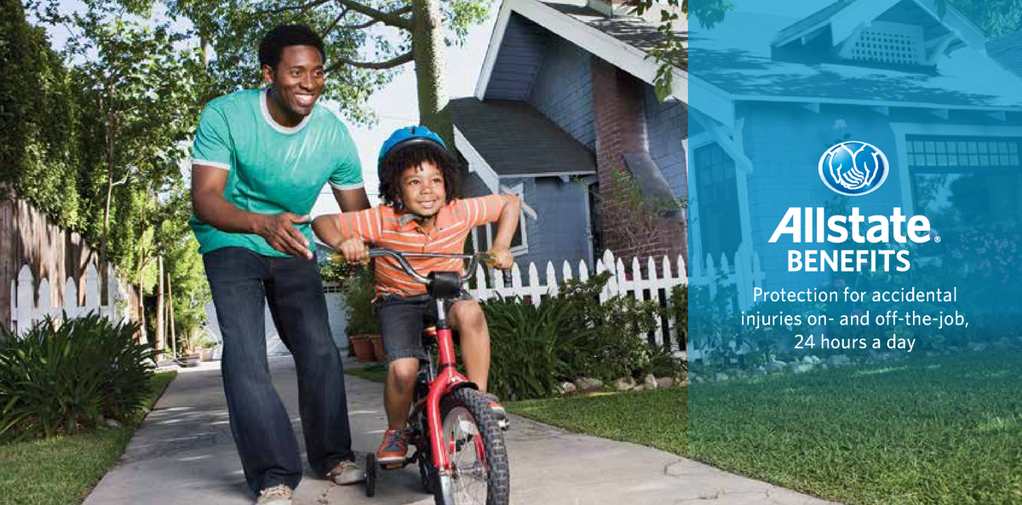
Group Accident Plan, 2
Guaranteed Issue
BeneCom

Slide 4


Group Accident 2
Pays Cash Benefits Directly to you!
Accident coverage gives financial protection with cash benefits paid directly to you.
Benefits:
Accidental Death Up to $70,000 - or $175,000 if common carrier
Dismemberment Up to $70,000
Dislocation or Fracture Up to $5,000
Hospital Confinement $400/day per person up to 365 days
Intensive Care $800/day per person up to 180 days
Initial Hospital Confinement $2,000 pays once per covered person per year
Ambulance $350 ground, $1,050 air
Accident Treatment $175 Physician *plus any additional $175 Urgent Care benefits applicable
                $350 Emergency Room
Follow up Treatment $200/day x2 per person per accident
Outpatient Physician Treatment $50/day – 2/person/yr, 4/EE+dependents/yr max
  “dr visit” benefit ($100/year or $200/year)

Slide 5

Group Accident 2 - continued
Lacerations per accident $200
Burns ≤15% or ≥15% $400 or $2000
Skin Graft pays % of burn benefit 50%
Brain Injury Diagnosis $1200
Paralysis $30k para $60k quad
Coma w Respiratory Assist $40,000
Blood and Plasma $1200 per person/accident
General Anesthesia $400
Appliance (crutch/walker/wheelchair) $500 per person/accident
Medicine $20 otc or RX
Physical Therapy $120/visit x6 visits
  Includes Chiropractic! *per person per accident
Ruptured Disc Surgery $2000
Misc. Surgery $400
Eye Surgery $400
Broken Tooth $400 excludes chew/bite
Open Abdomin/Thoracic SX $4000
Medical Supplies $20 otc supplies
Prosthesis 1 or 2 devices $2000/$4000
Rehabilitation Unit (60 day max yr) $400/day 30 days
Family Member Lodging $400 day 100 + miles
Post-Accident Transportation $600 carrier 250 + miles
  Post 3+ day confinement
Tendon, Ligament, Rotator Cuff, Knee Cart. Surgery surgery/exploratory $2000/$600
C.T. Scan or MRI $200 per person/year

Slide 6
Group Accident 2
Guaranteed Issue coverage, meaning no medical questions to answer
Coverage available for dependents
Premiums are affordable and are conveniently payroll deducted
Coverage may be continued if you leave your employer, as long as premiums are paid
MODE | EE | EE + SP | EE + CH | F
Semi-Monthly (pre tax) -22.5% | PLAN 2 $11.93 then (2.68 save) | PLAN 2 $20.63 then (4.64 save) | PLAN 2 $24.90 then (5.60 save) | PLAN 2 $32.86 then (7.39 save)
See Benecom Representative & Brochures for full benefit details.

Slide 7

Group Supplemental Health Insurance – aka “SHOP”
BeneCom

Slide 8

Group SHOP
Pays Cash Benefits to You!
Supplemental coverage to help pay for out-of-pocket expenses
Benefits
Initial Hospital Confinement 24 hrs admitted $830 per person / per year
Daily Hospital Confinement $330/day (per person up to 6 months per incident)
Intensive Care $330/day (per person up to 6 months per incident)
Outpatient Emergency Room (Accident) $415 per visit (2 per year / per person)
Inpatient Physician’s Treatment $41 daily (matches same number of days in the hospital)
Non-Local Transportation $249 per trip ( beyond 100 miles) 3 max
Ambulance Services $249 per trip (3 trips per person/ per year)
Surgery & Anesthesia (in or outpatient) up to $825/surgery +25% for anesthesia
At Home Nursing $83 day / 30 visits
Outpatient Physician Treatment $41/day (EE 5 visits, EE/spouse or children 10 visits, Family 15 visits)
  “Dr office visit” $205, $410, or $615 annually!
Benefits increase by 5% after the first coverage year & each coverage year thereafter for the next 5 years

Slide 9
Group SHOP
Supplemental coverage that can help pay for out-of-pocket hospital expenses
No maximum issue age
Benefits paid directly to insured, unless assigned elsewhere
Ages | EE | EE * SP | EE & CH | F
18-35 | $15.98 ( Save 3.60) | $30.15 (Save 6.78) | $25.81 (Save 5.81) | $39.43 (Save 8.87)
36-49 | $18.72 (Save 4.21) | $35.46 (Save 7.98) | $29.81 (Save 6.71) | $45.94 (Save 10.34)
50-59 | $23.31 (save 5.24) | $45.63 (save 10.27) | $34.15 (Save 7.68) | $55.83 (Save 12.58)
60-64 | $31.14 (Save 7.06) | $62.28 (Save 14.01) | $41.22 (Save 9.27) | $71.61 (Save 16.11)
65+ no age limit | $41.72 (save 9.39) | $83.43 (save 18.77) | $51.84 (Save 11.66) | $92.67 (Save 20.85)
See Benecom Representative & Brochures for full benefit details.

Slide 10

Critical Illness Policy
BeneCom

Slide 11

Group Critical Illness
Pays Cash Benefits to You!
Critical Illness coverage provides a lump-sum cash benefit to give financial support when needed the most.
Dependents receive 50% of your benefit.
Benefits
Advanced Alzheimer’s $ 5,000
Advanced Parkinson’s $ 5,000
Benign Brain Tumor $20,000
Coma $20,000
Complete Loss of Hearing $20,000
Complete Blindness $20,000
Paralysis $20,000
Heart Attack $20,000
Stroke $20,000
End Stage Renal Failure $20,000
Major Organ Transplant $20,000
Coronary Artery Bypass $ 5,000
Second Event Benefit Included
Waiver of Premium * employee only
See Benecom Representative & Brochures for full benefit details.

Slide 12

Group Critical Illness
Wellness benefit of $75 per covered person per year
*MANY EXAMS QUALIFY, see your BeneCom representative or Allstate brochure for details!

Slide 13
Group Critical Illness
Benefits paid regardless of any other coverage
Coverage may be continued when you leave the County or retire!
Non-Tobacco
AGES | EE, EE+CH | EE+SP, F
18-24 | $2.78 (Save .63) | $4.23 (Save .95)
25-29 | $2.96 (Save .67) | $4.59 (Save 1.03)
30-35 | $3.71 (Save .83) | $5.71 (Save 1.28)
36-39 | $4.61 (Save 1.04) | $7.17 (Save 1.61)
40-44 | $5.82 (Save 1.31) | $8.98 (Save 2.02)
45-50 | $7.76 (Save 1.75) | $11.84 (Save 2.66)
51-54 | $10.25 (Save 2.31) | $15.52 (Save 3.49)
55-60 | $13.45 (Save 3.03) | $20.29 (Save 4.57)
61-70 | $18.01 (Save 4.05) | $26.98 (Save 6.07)
71+ | $29.00 (Save 6.53) | $43.38 (Save 9.76)

Slide 14

Cancer Insurance & 29 specified diseases
BeneCom

Slide 15

Cancer Insurance & 29 specified diseases
In addition to Cancer, this plan also covers 29 specified diseases to help with expenses:
Muscular Dystrophy, ALS (Lou Gehrig’s), Multiple Sclerosis, Encephalitis, Rabies, Tetanus, Tuberculosis, Diphtheria, Cerebrospinal Meningitis (bacterial), Sickle Cell Anemia, Hepatitis (Chronic B or C with liver failure or Hepatoma), Lyme Disease, Systemic Lupus Erythematosus, Cystic Fibrosis, and many more!
29 additional diseases covered
Benefits
Internal Cancer Initial Diagnosis Benefit $5,000
Hospital Confinement
Continuous Hospital Confinement $200 day
Extended Benefits no lifetime limit $200 day
Government/Charity Hospital $200 day
Private Duty Nursing Services $200 day
Extended Care Facility $200 day
At Home Nursing $200 day
Hospice Care - home or center $200 day
Radiation/Chemotherapy
Radiation/Chemo $10,000
Blood, Plasma, and Platelets $10,000
Surgery & Related Benefits
Surgery inpatient/outpatient $1,500/$2,250
Anesthesia % of surgery 25%
Ambulatory Surgical Center $250 daily
Second Opinion $200
Bone Marrow/Stem Cell Transplant up to $2,500
Transportation & Lodging
Ambulance $100
Non-Local Transportation .40 cents mile
Outpatient Lodging $50 day
Family Lodging/Transportation $50 day/.40 mile
*See BeneCom Representative & Brochure for full details and rates.

Slide 16
Cancer Insurance & 29 specified diseases
Benefits - continued
Surgery & Related Benefits
Surgery inpatient/outpatient $1,500/$2,250
Anesthesia % of surgery 25%
Ambulatory Surgical Center $250 daily
Second Opinion $200
Bone Marrow/Stem Cell Transplant up to $2,500
Transportation & Lodging
Ambulance $100
Non-Local Transportation .40 cents mile
Outpatient Lodging $50 day
Family Lodging/Transportation $50 day/.40 mile
Physician’s Attendance $50 day
Physical or Speech Therapy $50 day
Experimental Treatment $5,000 /12 mo
Prosthesis $2,000
Comfort/Anti-Nausea $200
Intensive Care Benefit any reason $ 200 day/45 days
Cancer Screening Benefit - $100 per covered person per year!
*many exams qualify : see your representative & brochure for details
*see BeneCom representative & brochure for full policy and premium details

Slide 17
Cancer Insurance & 29 specified diseases
Benefits are paid directly to you unless otherwise assigned
Waiver of premium after 90 days of disability due to cancer for as long as your disability lasts (EE only)
Coverage may be continued when you retire or leave the County.
 | EE | F
Semi-Monthly (pre-tax 22.5% save) | $12.01 (2.70 save) | $20.60 (4.64 save)

Slide 18

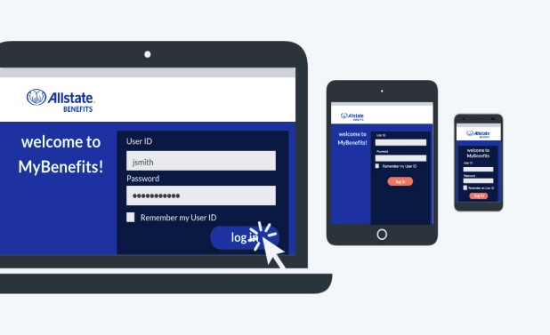
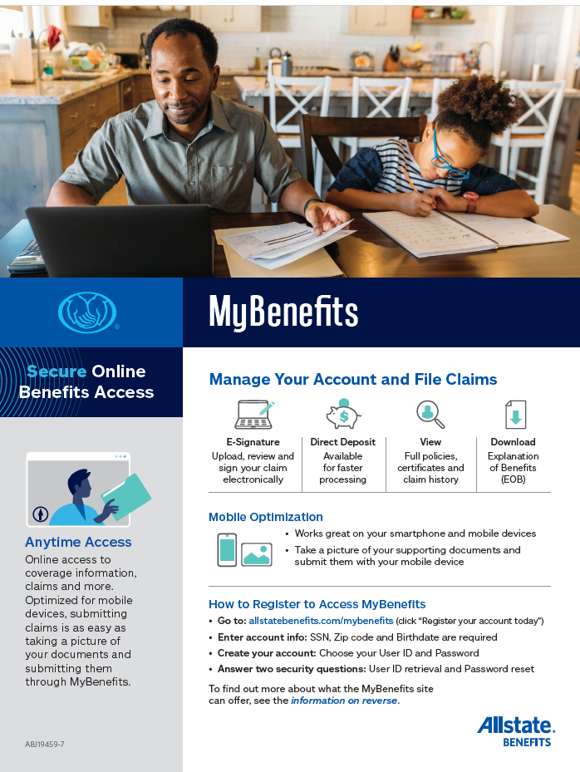

Policyholder Services
The Claims team is made of dedicated, compassionate employees who strive to make customers “whole” as quickly as possible
98% of claims completed within 3-5 days – current average just 2 days
MyBenefits App & Website – 24/7 Policy Management, Claims submission & tracking
Claim reimbursements electronically deposited into the customer’s checking or savings account
10% of all claims are reviewed for quality and audited for financial and statistical accuracy
Reports on the number of claims received, turnaround times and quality are provided on an annual basis
Contact BeneCom anytime for claims support & assistance of any kind!
Scan code for Allstate’s MyBenefits Mobile App!

Slide 19


Aflac Voluntary Benefits
Dental Supplement
Vision Supplement
BeneCom

Slide 20

Dental Essentials Supplement
You Choose Your Dentist! & You and your dentist choose the treatment plan!
NO annual deductible or co-pays
Aflac Dental pays benefits regardless of any other plan
POLICY YEAR MAXIMUM $2,100 per person | per calendar year, then reset, plus:
  Aflac’s Annual Maximum Building Benefit increases each covered person’s Max $150 year up to a $750 Maximum per Covered Person additional coverage at no additional cost!
Preventative No waiting Period $25-$45
Filings & Basic Services 3 months $25-$390
Pain Management 3 months $45-$215
Other Preventative Services 6 months $30-$175
Oral Sx, Gums, Prosthetic repair 6 months $40-$1,300
Crowns and Major Services 12 months $30-$605
Major Prosthetic Services 24 months $75-$780
Semi-monthly rates | Employee | Employee +child(ren) | Employee +Spouse | Family
*pretax savings illustration | $11.64 *2.62 | $20.35 *4.58 | $20.48 *4.61 | $29.32 *6.60

Slide 21
Aflac Vision Now - Supplement
No provider network, no coordination of benefits!
3 plan designs available!
Eye exam benefit $55 per person per year
Vision correction materials $105 per person per year
Eye exam benefit $55 per person per year
Vision correction materials $260 per person per 24 months
Eye exam benefit $55 per person per year
Vision correction materials $450 per person per 36 months

Slide 22
Aflac Vision Now - Supplement
All 3 plan options include:
Specific Eye Disease/Disorder Benefit
$1,100 once per person per covered disease/disorder
-
Eye Surgery Benefit
Up to $1,650 per surgery, no lifetime max
-
Permanent Visual Impairment
Up to $11,000 – lifetime max of $22,000 per covered person
Glaucoma, Proliferative diabetic retinopathy, Retinitis pigmentosa, retinal detachment, macular degeneration
Paid based on schedule of operations, see brochure/representative for details
Based on specific levels of impairment, see brochure/representative for details
-
Semi-Monthly RATES (pre- tax discount)
Age Individual One Parent Family Insured/Spouse Two Parent Family
18-39 $5.40 (Save 1.22) $8.91 (Save 2.00) $8.52 (Save 1.92) $11.25 (save 2.53)
40-49 $7.35 (Save 1.65) $10.27(Save 2.31) $12.42 (Save 2.79) $14.56 (Save 3.28)
50-70 $11.05 (Save 2.49) $12.81 (Save 2.88) $19.05 (Save 4.29) $19.44 (save 4.37)

Slide 23




US Legal Benefits
Specifically designed for Hillsborough County
Providing justice for all since 1974
BeneCom

Slide 24

U.S. LEGAL SERVICES, INC.
Why you need legal insurance
Everyone experiences milestones where legal and financial guidance would be a huge relief, in both good times and bad. Individuals at every stop in life can benefit from legal assistance:
  Prenuptial agreement
  Purchasing a home
  Adopting a child
  Saving for college
  Preparing a will/estate plan
  Probate
  Medical malpractice
  Defense of elder scams
  Financial coaching
  Insurance disputes
Benefits to Employees:
  Easy to use access to legal assistance for all common personal legal matters
  Local and nationwide access to over 10,000 highly vetted, experienced attorneys
  Reduced overall stress
  Decreased financial strain of legal issues
  Proactive legal and financial resources
  Getting a divorce
  Establishing child support
  Changing your name
  Refinancing your home
  Filing for bankruptcy
  Leasing an apartment
  Developing a budget
  Purchasing a car
  Getting a ticket
  Understanding taxes
  Establishing guardianship
  Updating your estate plan
  Creating a trust
  Planning for retirement
  Selling your home
$3K
USL saves our members an average of over $3,000 per year and countless hours in productivity.

Slide 25

US Legal Family Defender® At a Glance
U..
$9.37 semi-monthly
Family premium includes coverage for the employee, spouse, and eligible dependent children up to age 26.
Civil Litigation
  Plaintiff or Defendant
  Administrative Hearings
  Trial Coverage up to $15,000
  Small Claims
  Name Change
  Landlord/Tenant Matters
Family Law*+
  Divorce – Contested & Uncontested
  Annulments
  Spousal Support
  Paternity Action
  Child Support/Custody
  Post-Decree Enforcement Action
  Post-Decree Modification Action
  Equitable Distribution of Assets
Other Family Law
  Pre/Postnuptial Agreements
  Domestic Adoption
  Domestic Violence
Immigration Matters
  Visa Extension
  Naturalization
  Deportation (Removal)
Traffic Violations
  Moving Traffic Violations
  First Offense DUI
  License Revocation & Suspension
Consumer-Seller Protection
  Consumer Protection Matters
  Personal Property Protection
  Trial Coverage up to $15,000
Criminal Law
  Misdemeanor Defense
  Juvenile Defense
  Habeas Corpus
  Trial Coverage up to $15,000
Contingency Matters**
  Personal Injury
  Auto Accidents
  Medical Malpractice
Document Preparation & Review
  Demand Letters
  Quit Claim Deeds
  Personal Affidavit
  Promissory Note
  Bill of Sale
  Personal Contract

Slide 26
Family Defender® At a Glance - continued
Real Estate Transactions
  Review and/or Preparation of Purchase Agreement, Mortgage, and Deed
  Purchase/Sale of Primary & Secondary Residence
  Refinancing of Residence
  Attorney Attendance at Closing
  Real Estate Disputes
  Neighbor Disputes
Estate Planning
  Living Will
  Powers of Attorney
  Wills & Testamentary Trusts
  Codicils
  Estate Administration/Probate
  Uncontested Guardianship or Conservatorship
Financial Matters
  Debt Collection Defense
  Garnishment Defense
  Foreclosure+
  Limiting Creditor Harassment
  Ch. 7 & 13 Bankruptcy+
Landlord Tenant Matters
  Eviction Defense
  Tenant Disputes
Other Legal Matters
  Insurance Law
  Standard Business Incorporation
  Elder Law Matters
*Contested matters subject to 12-hour
limitation, discount thereafter.
**First $1,000 exempt from fee. Subject
to State and Federal Statutes
+Subject to 120-day waiting period

Slide 27

Financial Wellness Suite NOW POWERED BY
Financial wellness benefits are included with the Family Defender to
help members achieve holistic legal and financial wellness.
Financial Crisis Manager
Financial Wellness Assessments
Financial Education
Secure Member Dashboard
Tax Benefits

Slide 28

Ready to enroll?
Have questions?
speak with a BeneCom representative today:
info@mybenecom.com
Bradley Shattuck cell: (813) 293-7489
BeneCom Office: (813) 996-2525
Visit www.benecom.com/hctc2025 for your Employee Specific BeneCom site!
SCAN
ME!
Get our mobile app today, and have us at your fingertips!
Scan code here, or Text “BeneCom” to 36260

Slide 29



Thank You,
Hillsborough County Employees!
We look forward to speaking with you!

